Slide 1
Error Code Small Group
AIRA

Slide 2
Scope
In Scope
Looking at PID to start with
ERR-5: Adding new codes to list
Minor changes to existing codes possible
Most common and fatal errors Need this information from the group.
Criteria for adding new codes (how specific / generic they should be)
Categorization, Tagging?
ERR-2 Could be used to provide context for generic concepts
Might be a strategy to combine specific / generic, levels, use both
Meta Information
Cross linking with Data Validation Guide (combined document) - Link to specific section in a guide, might also be conformance statement in IG
Flag items that are clinically possible so should not ever be hard errors
Perhaps provide guidance on valid/invalid severity codes?
Actor/Action – could get some feedback from IIP
Look at Actor terms/types, need to make sure the text makes sense for clinician?
ERR-9 Inform Person Indicator – if we could categorize we could message this, come up with suggested values (Stretch goal, if we have time)
Future Work
ERR-7 Diagnostic Information
ERR-8 User Message
QBP related errors
Out of Scope
ERR-4 Severity – determined by IIS at run time
ERR-3 HL7 Error Code – set by HL7, we can’t change it
Notes:
The champion should propose to the group an initial scope. The group should discuss, but this does not have to be finalized in the Kick Off meeting. If the discussion lasts for more than 10 minutes then the discussion will continue on the first call of the group. It usually takes two meetings to get the scope set for sure.

Slide 3
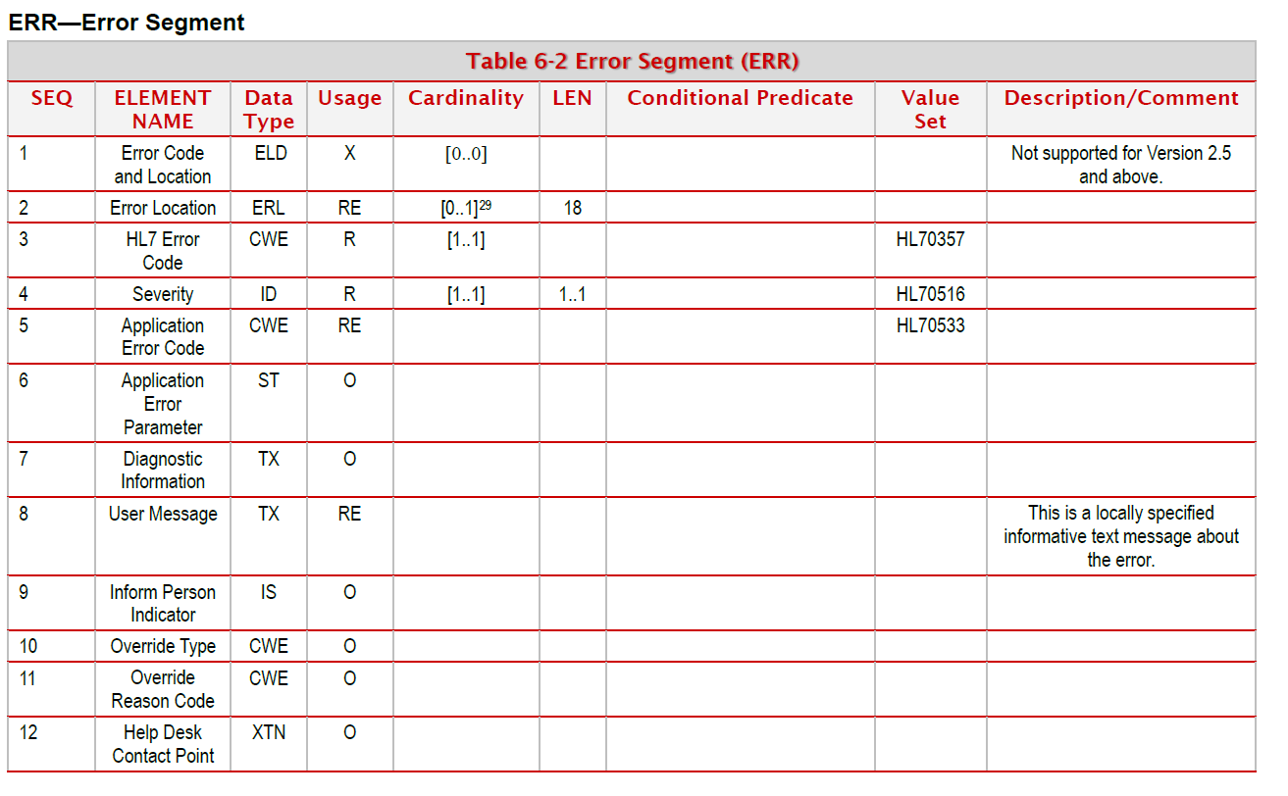

Slide 4
Task Participants
Guidance Document | Test Cases | Technical Demonstrations
Chrissy Miner Craig Newman Maia Ouderkirk Danny Wise Kevin Snow Stephen Hill | Jane Lammers Jason Suchon Heather Crawford Lori Reed-Fourquet Nathan Bunker | Going forward SISC Small Groups will only focus on two of these three areas. Guidance Document Test Cases - or - Test Cases Technical Demonstrations

Slide 5
Deliverables
Area | Deliverable
Guidance | Create guidance on creating new codes Propose some new codes Focus on a narrow scope? (e.g. PID segment) Look at data quality business rules? Update guidance document
Test Cases | Create process for developing test cases Create test cases for current codes Create test cases for common issues

Slide 6
Schedule & Communication
Thursday (today)
2pm ET – Begin
5pm ET? – Regroup for update?
Friday
10am ET – Regroup for update?
2pm ET – Closing/wrapup
Slack Updates
Designate one person to update slack every hour
Switch calls if needed

Slide 7
Conference Lines
Guidance Document
202-539-8990 | www.uberconference.com/krutland
Test Cases
202-871-0098 | www.uberconference.com/nbunker

Slide 8
Resources
GitHub wiki:
https://github.com/immregistries/sisc-error-codes/wiki
Project files:
https://github.com/immregistries/sisc-error-codes
Error Code spreadsheet on Google docs:
https://docs.google.com/spreadsheets/d/1in7FAdKQiQxtB4u2bzJHf1qM5pV05_FVXtwH5AuDIQ4/edit?usp=sharing
Test development site:
https://florence.immregistries.org/aart/transformTest

